Slide 1
Digital Image Processing: Digital Imaging Fundamentals

Slide 2
Contents
This lecture will cover:
The human visual system
Light and the electromagnetic spectrum
Image representation
Image sensing and acquisition
Sampling, quantisation and resolution

Slide 3
Human Visual System
The best vision model we have!
Knowledge of how images form in the eye can help us with processing digital images
We will take just a whirlwind tour of the human visual system

Slide 4
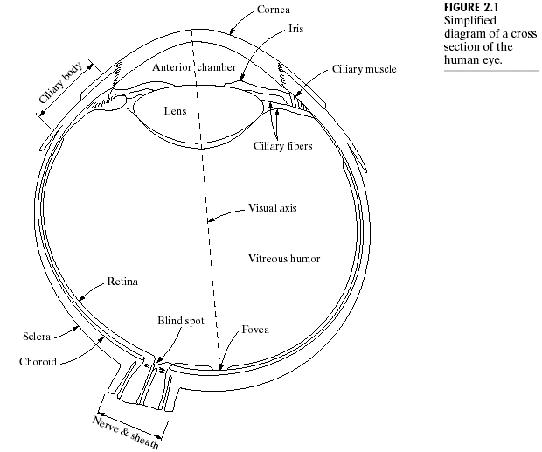

Structure Of The Human Eye
The lens focuses light from objects onto the retina
The retina is covered with light receptors called cones (6-7 million) and rods (75-150 million)
Cones are concentrated around the fovea and are very sensitive to colour
Rods are more spread out and are sensitive to low
levels of illumination
Images taken from Gonzalez & Woods, Digital Image Processing (2002)
Notes:
Cornea and sclera keep everything in!
The choroid contains all of the blood vessels that serve as nutrition to the eye
The iris contains the pigment that gives our eyes their colour
Rods for general vison cones for details
Blind spot is where the optic nerve connects
BLIND SPOT EXPERIMENT
Women have extra cones which means they can see more colours

Slide 5

Blind-Spot Experiment
Draw an image similar to that below on a piece of paper (the dot and cross are about 6 inches apart)
Close your right eye and focus on the cross with your left eye
Hold the image about 20 inches away from your face and move it slowly towards you
The dot should disappear!

Slide 6


Slide 7
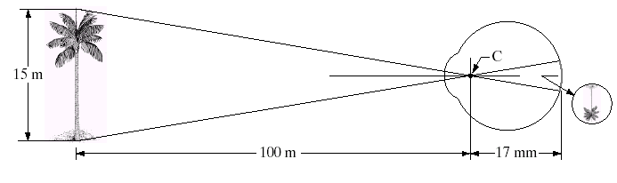
Image Formation In The Eye
Muscles within the eye can be used to change the shape of the lens allowing us focus on objects that are near or far away
An image is focused onto the retina causing rods and cones to become excited which ultimately send signals to the brain

Slide 8
Brightness Adaptation & Discrimination
The human visual system can perceive approximately 10¹⁰ different light intensity levels
However, at any one time we can only discriminate between a much smaller number – brightness adaptation
Similarly, the perceived intensity of a region is related to the light intensities of the regions surrounding it

Slide 9
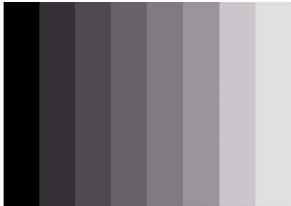

Brightness Adaptation & Discrimination (cont…)
Images taken from Gonzalez & Woods, Digital Image Processing (2002)
An example of Mach bands
Notes:
Mach bands were named after Ernst Mach who described the phenomenon in 1865

Slide 10
Brightness Adaptation & Discrimination (cont…)
Images taken from Gonzalez & Woods, Digital Image Processing (2002)
Notes:
Mach bands were named after Ernst Mach who described the phenomenon in 1865

Slide 11
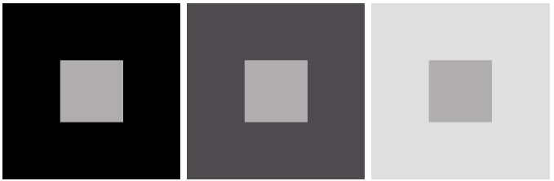
Brightness Adaptation & Discrimination (cont…)
Images taken from Gonzalez & Woods, Digital Image Processing (2002)
An example of simultaneous contrast
Notes:
Mach bands were named after Ernst Mach who described the phenomenon in 1865

Slide 12
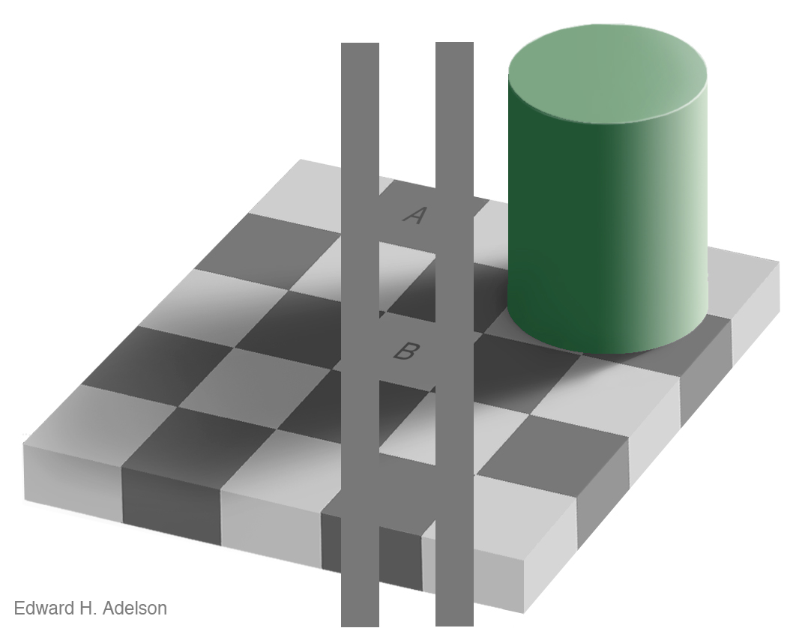
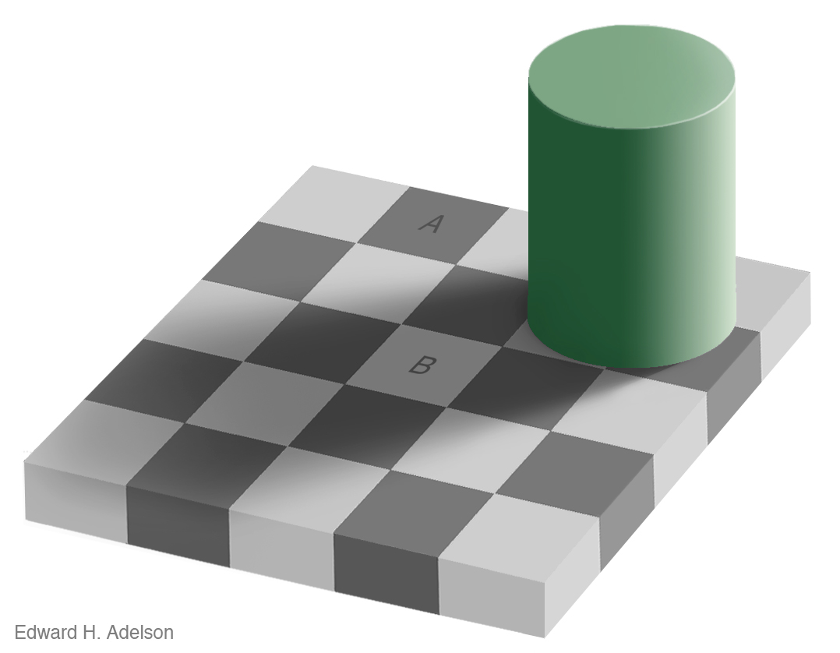
Brightness Adaptation & Discrimination (cont…)
For more great illusion examples take a look at: http://web.mit.edu/persci/gaz/
Notes:
Mach bands were named after Ernst Mach who described the phenomenon in 1865

Slide 13
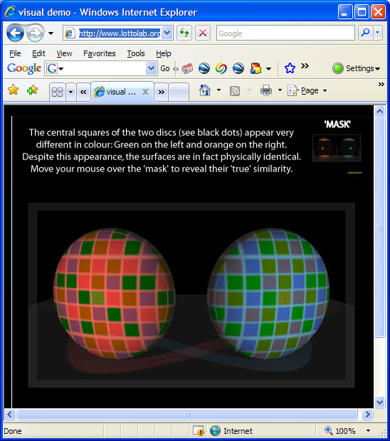
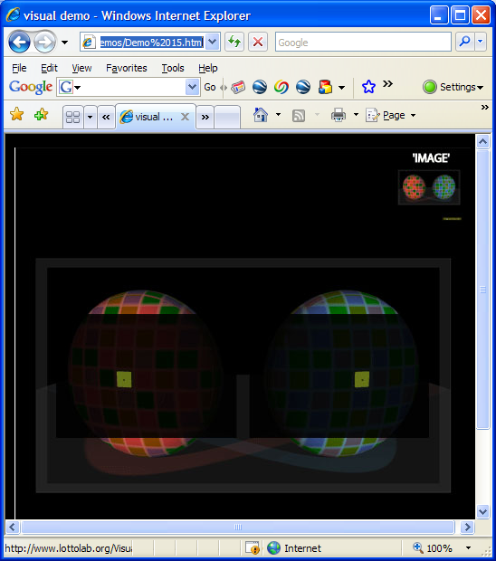
Available here: http://www.lottolab.org/Visual%20Demos/Demo%2015.html

Slide 14
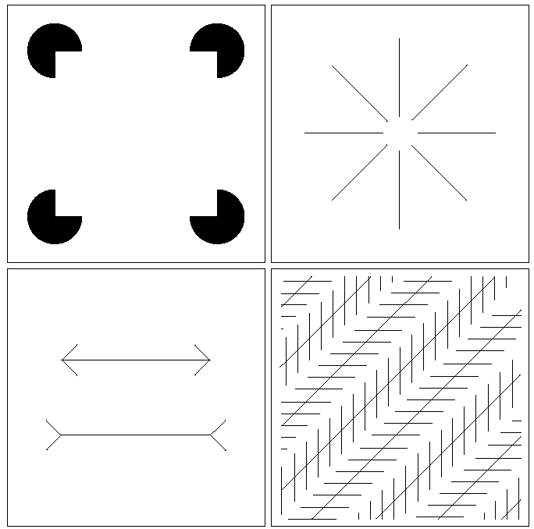
Optical Illusions
Our visual systems play lots of interesting tricks on us

Slide 15
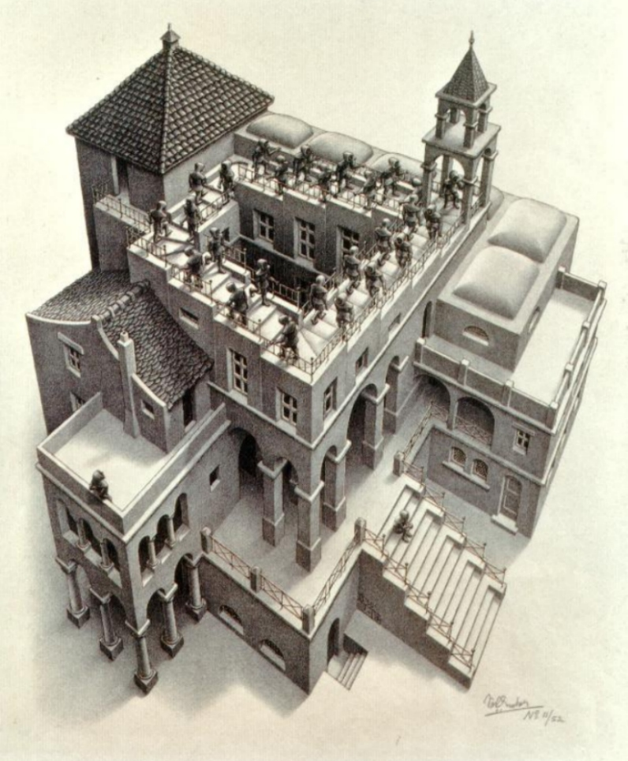
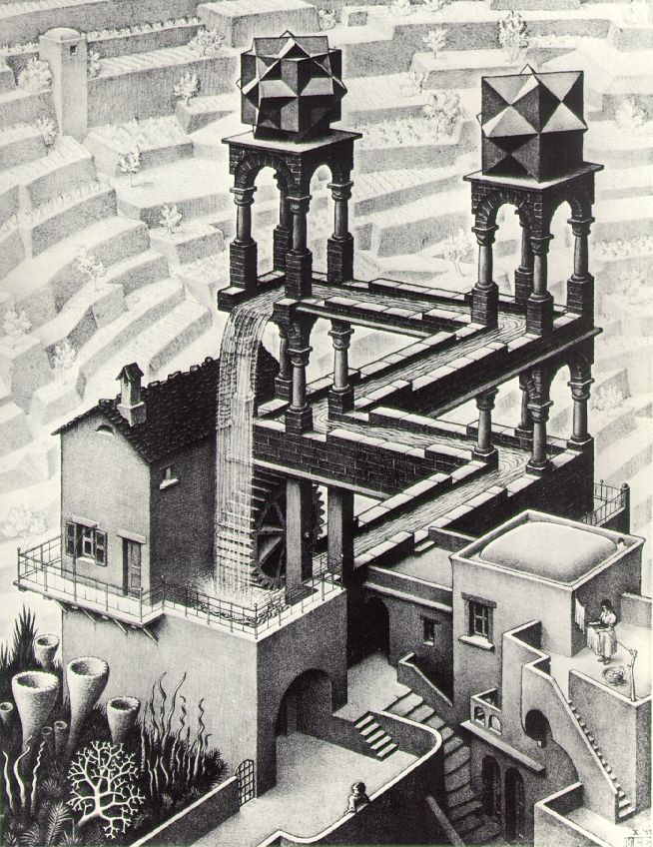
Optical Illusions (cont…)

Slide 16
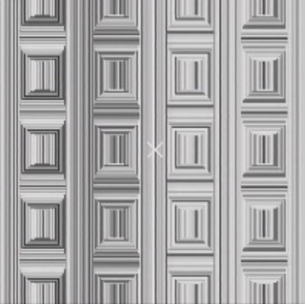
Optical Illusions (cont…)
Stare at the cross in the middle of the image and think circles

Slide 17
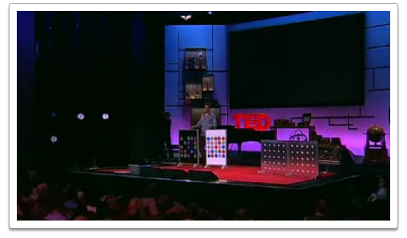

Mind Map Exercise: Mind Mapping For Note Taking
Beau Lotto: Optical Illusions Show How We See
http://www.ted.com/talks/lang/eng/beau_lotto_optical_illusions_show_how_we_see.html

Slide 18
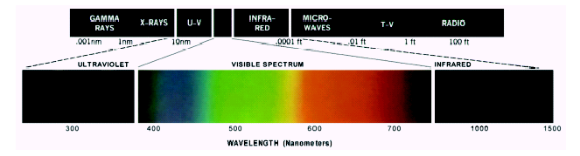
Light And The Electromagnetic Spectrum
Light is just a particular part of the electromagnetic spectrum that can be sensed by the human eye
The electromagnetic spectrum is split up according to the wavelengths of different forms of energy
Notes:
In 1666 Sir Isaac Newton discovered that light passed through a prism splits into a continuous spectrum of colours
Many image applications use electromagnetic radiation that is far outside the visual spectrum – x-ray images, infra-red images – we genrate images of these images by mapping them to the visual spectrum

Slide 19
Reflected Light
The colours that we perceive are determined by the nature of the light reflected from an object
For example, if white light is shone onto a green object most wavelengths are absorbed, while green light is reflected from the object
White Light
Colours Absorbed
Green Light

Slide 20
Sampling, Quantisation And Resolution
In the following slides we will consider what is involved in capturing a digital image of a real-world scene
Image sensing and representation
Sampling and quantisation
Resolution

Slide 21
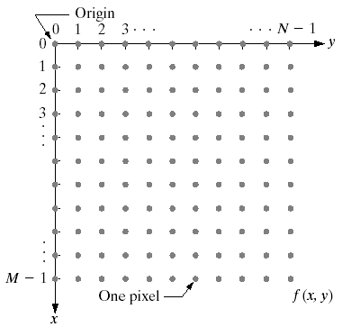
Image Representation
Before we discuss image acquisition recall that a digital image is composed of M rows and N columns of pixels each storing a value
Pixel values are most often grey levels in the range 0-255(black-white)
We will see later on that images can easily be represented as matrices
col
Images taken from Gonzalez & Woods, Digital Image Processing (2002)
f (row, col)
row

Slide 22

Image Acquisition
Images are typically generated by illuminating a scene and absorbing the energy reflected by the objects in that scene
Typical notions of illumination and scene can be way off:
X-rays of a skeleton
Ultrasound of an unborn baby
Electro-microscopic images of molecules
Images taken from Gonzalez & Woods, Digital Image Processing (2002)

Slide 23
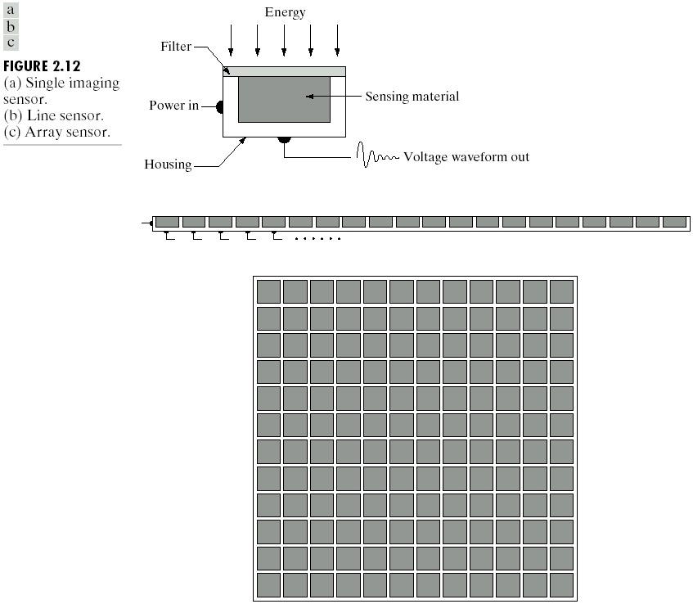
Image Sensing
Incoming energy lands on a sensor material responsive to that type of energy and this generates a voltage
Collections of sensors are arranged to capture images
Images taken from Gonzalez & Woods, Digital Image Processing (2002)
Imaging Sensor
Line of Image Sensors
Array of Image Sensors

Slide 24
Image Sensing
Images taken from Gonzalez & Woods, Digital Image Processing (2002)
Using Sensor Strips and Rings

Slide 25
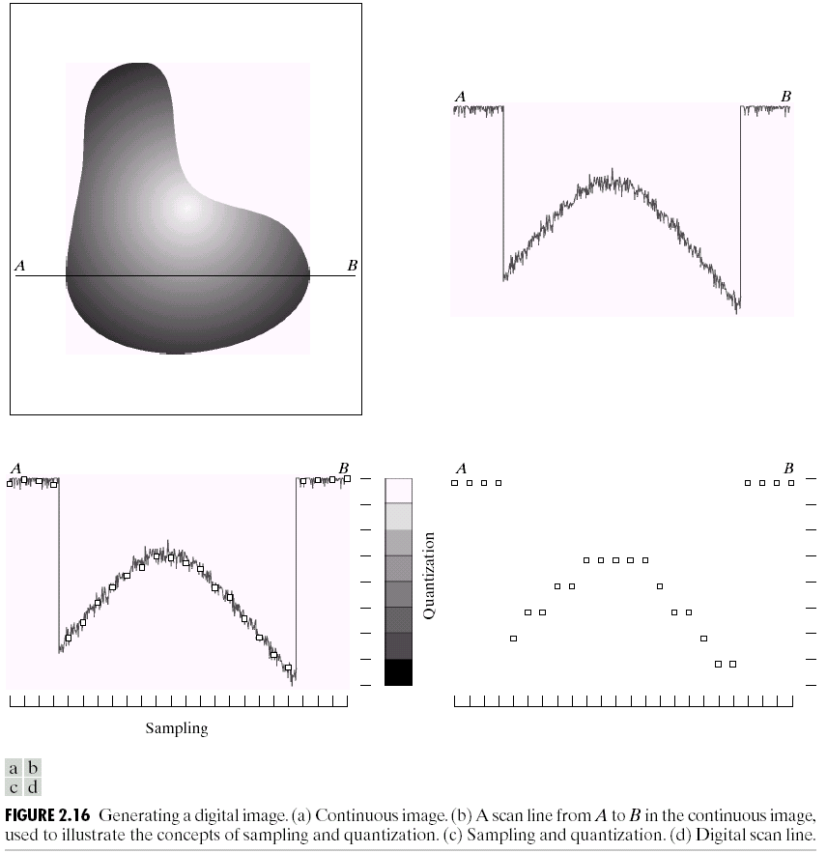
Image Sampling And Quantisation
A digital sensor can only measure a limited number of samples at a discrete set of energy levels
Quantisation is the process of converting a continuous analogue signal into a digital representation of this signal
Images taken from Gonzalez & Woods, Digital Image Processing (2002)
Notes:
Analogue Vs digital
Think of the volume knob on your stereo
Records Vs CDs Vs Mp3s
Nyquist theory etc talks about how much sampling we need to do

Slide 26
Image Sampling And Quantisation
Images taken from Gonzalez & Woods, Digital Image Processing (2002)
Notes:
Analogue Vs digital
Think of the volume knob on your stereo
Records Vs CDs Vs Mp3s
Nyquist theory etc talks about how much sampling we need to do

Slide 27
Image Sampling And Quantisation
Images taken from Gonzalez & Woods, Digital Image Processing (2002)
Notes:
Analogue Vs digital
Think of the volume knob on your stereo
Records Vs CDs Vs Mp3s
Nyquist theory etc talks about how much sampling we need to do

Slide 28

Image Sampling And Quantisation (cont…)
Remember that a digital image is always only an approximation of a real world scene
Images taken from Gonzalez & Woods, Digital Image Processing (2002)

Slide 29
Image Representation
Images taken from Gonzalez & Woods, Digital Image Processing (2002)

Slide 30
Image Representation
Images taken from Gonzalez & Woods, Digital Image Processing (2002)

Slide 31
Image Representation
Images taken from Gonzalez & Woods, Digital Image Processing (2002)

Slide 32
Image Representation
Images taken from Gonzalez & Woods, Digital Image Processing (2002)

Slide 33
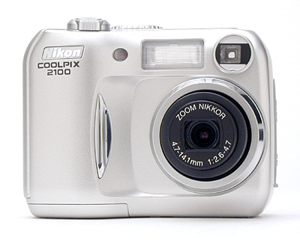
Spatial Resolution
The spatial resolution of an image is determined by how sampling was carried out
Spatial resolution simply refers to the smallest discernable detail in an image
Vision specialists will often talk about pixel size
Graphic designers will talk about dots per inch (DPI)
5.1 Megapixels

Slide 34
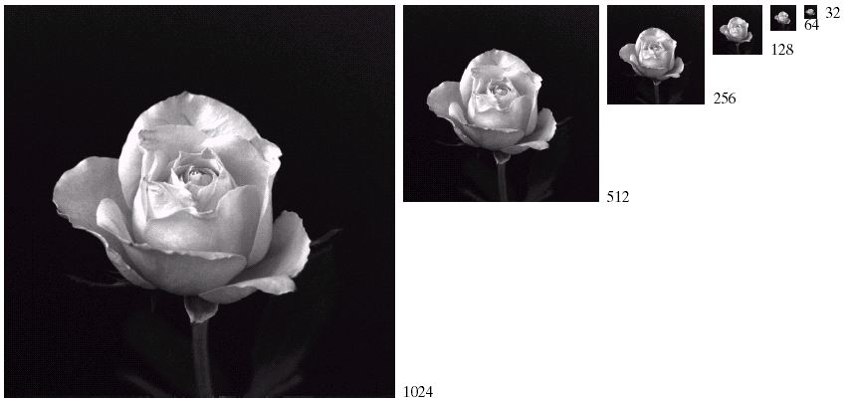
Spatial Resolution (cont…)
Images taken from Gonzalez & Woods, Digital Image Processing (2002)

Slide 35
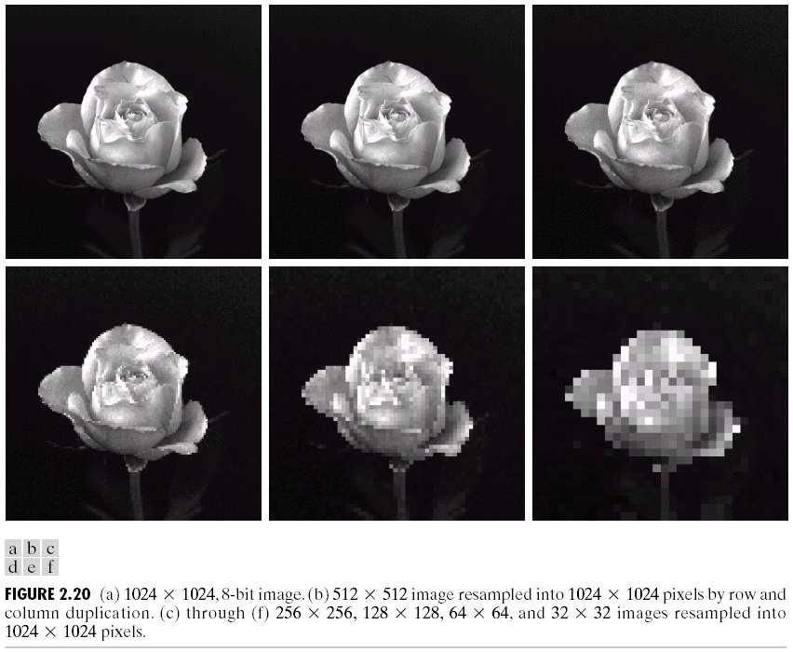
Spatial Resolution (cont…)
Images taken from Gonzalez & Woods, Digital Image Processing (2002)

Slide 36
Spatial Resolution (cont…)
Images taken from Gonzalez & Woods, Digital Image Processing (2002)

Slide 37
Spatial Resolution (cont…)
Images taken from Gonzalez & Woods, Digital Image Processing (2002)

Slide 38
Spatial Resolution (cont…)
Images taken from Gonzalez & Woods, Digital Image Processing (2002)

Slide 39
Spatial Resolution (cont…)
Images taken from Gonzalez & Woods, Digital Image Processing (2002)

Slide 40
Spatial Resolution (cont…)
Images taken from Gonzalez & Woods, Digital Image Processing (2002)

Slide 41
Intensity Level Resolution
Intensity level resolution refers to the number of intensity levels used to represent the image
The more intensity levels used, the finer the level of detail discernable in an image
Intensity level resolution is usually given in terms of the number of bits used to store each intensity level
Number of Bits
Number of Intensity Levels
Examples
1
2
0, 1
2
4
00, 01, 10, 11
4
16
0000, 0101, 1111
8
256
00110011, 01010101
16
65,536
1010101010101010

Slide 42
Saturation & Noise
Images taken from Gonzalez & Woods, Digital Image Processing (2002)

Slide 43
Resolution: How Much Is Enough?
The big question with resolution is always how much is enough?
This all depends on what is in the image and what you would like to do with it
Key questions include
Does the image look aesthetically pleasing?
Can you see what you need to see within the image?

Slide 44

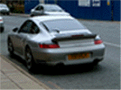
Resolution: How Much Is Enough? (cont…)
The picture on the right is fine for counting the number of cars, but not for reading the number plate

Slide 45
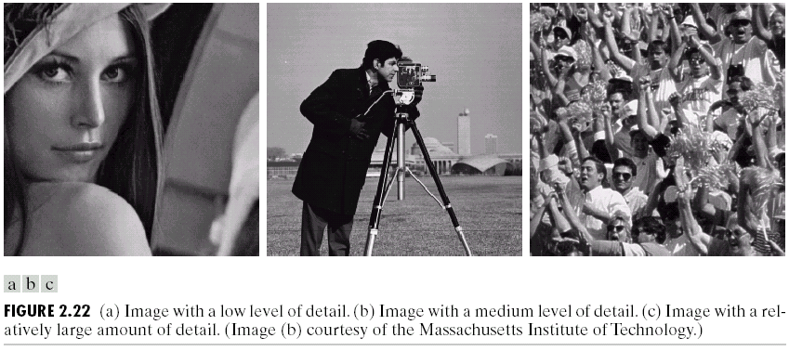
Intensity Level Resolution (cont…)
Images taken from Gonzalez & Woods, Digital Image Processing (2002)
Low Detail
Medium Detail
High Detail

Slide 46
Intensity Level Resolution (cont…)
Images taken from Gonzalez & Woods, Digital Image Processing (2002)

Slide 47
Intensity Level Resolution (cont…)
Images taken from Gonzalez & Woods, Digital Image Processing (2002)

Slide 48
Intensity Level Resolution (cont…)
Images taken from Gonzalez & Woods, Digital Image Processing (2002)

Slide 49
Summary
We have looked at:
Human visual system
Light and the electromagnetic spectrum
Image representation
Image sensing and acquisition
Sampling, quantisation and resolution

